Slide 1
Diagram Animator and Visualization Environment
Group 02
Boyan Dai, Erik Laurin, Elaine Qvarnström, Joacim Eberlen, Justinas Stirbys, Shaun McMurray

Slide 2
What was planned:
What was accomplished:
Business Plan and Vision
Setup Jenkins server
Design initial architecture
Design different SSD parts
Static SSD
Improved product backlog
Business Plan
Vision
Initial architecture
Static SSD and it’s components

Slide 3

Next Sprint
Class diagram
Distributed JSON parser in Erlang
Render system boxes and messages based on JSON

Slide 4

Areas of Improvement
-> ‘Learn in 3D’
Have an agenda for every meeting
More on track meetings
Tests

Slide 5
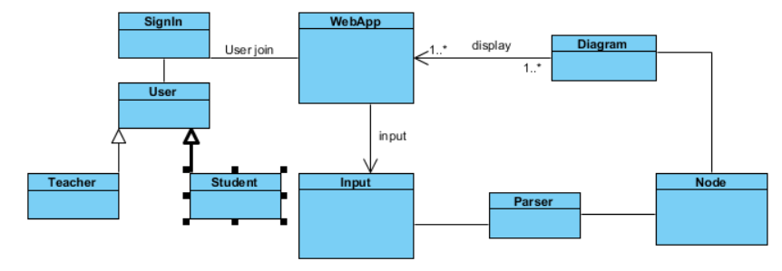
Initial Architecture

